Slide 1
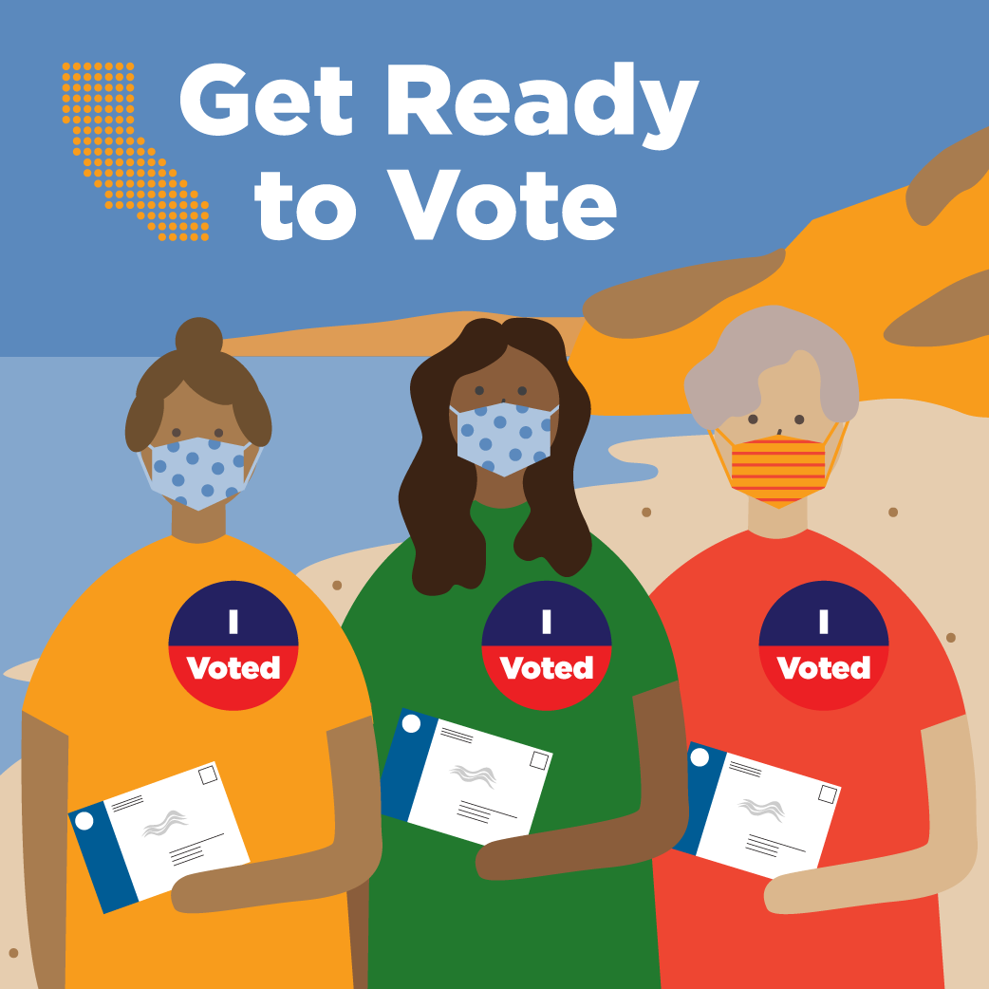
Voting Matters 2
6pm, Thursday, September 3
Special Guest: Tammy Patrick, Senior advisor with the democracy fund

Slide 2
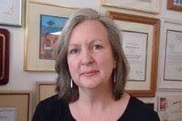
Welcome Tammy Patrick!
Tammy Patrick is a Senior Advisor to the Elections program at the Democracy Fund. Focusing on modern elections, Tammy joined the Democracy Fund in 2017 to help lead the effort to foster a voter-centric elections system and work to provide election officials across the country with the tools and knowledge they need to best serve their voters.
In 2013 she was selected by President Obama to serve as a Commissioner on the Presidential Commission on Election Administration (PCEA) which led to a position at the Bipartisan Policy Center to further the work of the commission. Prior to that she was the Federal Compliance Officer for Maricopa County Elections Department for eleven years where she established herself as a collaborative partner for those seeking to improve the American voting experience, testifying in more than a dozen state legislatures as well as in both the House of Representatives and the United States Senate.
She serves as an adjunct professor at the University of Minnesota’s Humphrey School of Public Policy and has represented the National Association of Election Officials (Election Center) to the United States Postal Service’s Mailers Technical Advisory Committee (MTAC) for over a decade. She holds a Bachelor’s Degree in American Studies from Purdue University and is certified by Auburn University as a Certified Elections Registration Administrator (CERA).

Slide 3
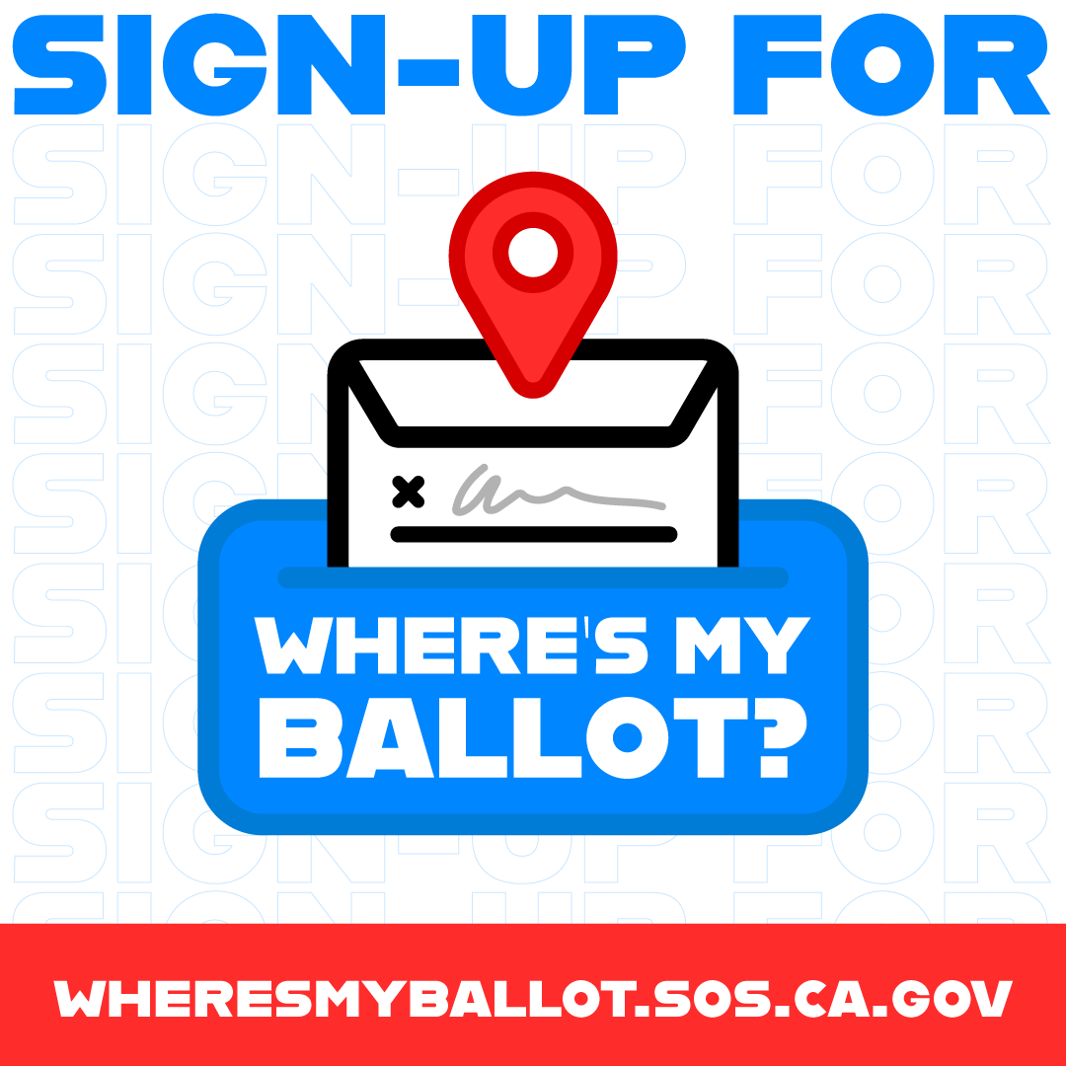
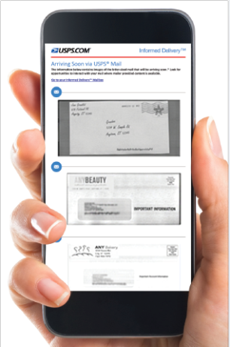
Can the post office deliver all these ballots?
Post office reps have reassured us there will be no problems with delivering ballots.
Sign up to track your ballot at wheresmyballot.sos.ca.gov
If we mail you a ballot, you will get an alert when :
  Your ballot enters the mail stream
  Your ballot is in your mailbox. Sign up for informed delivery at usps.com
  Your ballot is received and accepted by the county elections office
Other alerts may include: when your voted ballot enters the mail stream (if you are mailing it back), if there is a problem with your signature, if we can’t count your ballot for any reason, if your ballot is undeliverable.

Slide 4
Fire survivors
If you have lost your home or you cannot live there for the November 3 election
You do not have to re-register to vote.
You can keep your voting residence at your home in the fire evacuation area for as long as you need.
But, if you do not get mail there, you will need to give us a mailing address.
Complete the Change of Mailing address form online or at the Recovery Center.
Ballots CANNOT be forwarded. So, if you filed a forwarding address with USPS, you still need to update your mailing address with us. Otherwise, your ballot will be returned to us as undeliverable.
We must send our voter data to our ballot printer by September 14. So, if you change your address by then, your ballot will be sent to the correct address the first time.
If you do not receive your ballot, you can request a replacement ballot.
Call 831-454-2060 or
email 2ndballot@votescount.us
Or go to one of our 17+ in-person voting locations and obtain a ballot –
2 open Oct. 5, others open Oct. 31 to Nov. 3.

Slide 5
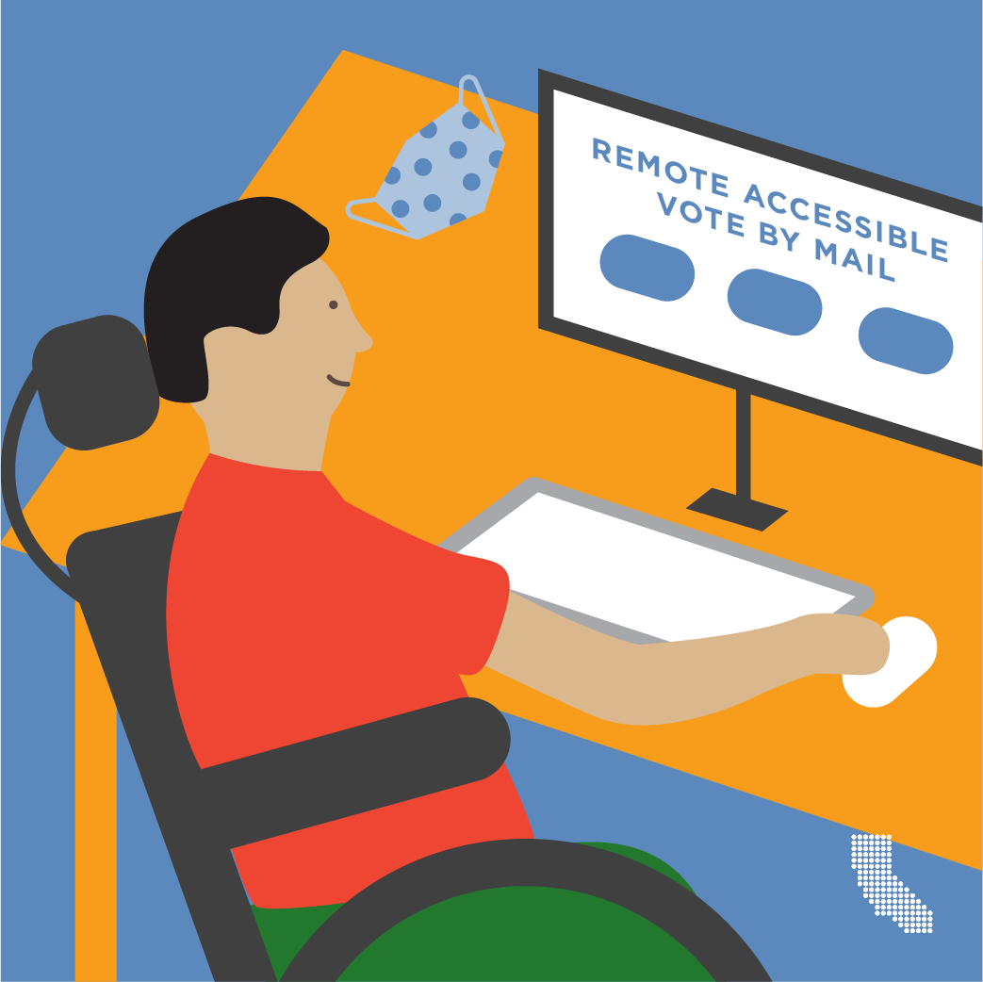
Remote Accessible Vote-by-Mail Ballot - RAVBM
If you who do not get mail delivery or cannot vote using a paper ballot, you can sign up for a Remote Accessible Vote-by-Mail ballot (RAVBM). This form of voting had been limited to military and overseas voters and voters with disabilities, but due to COVID-19 any voter may request a RAVBM.
To vote using a RAVBM, you need to have access to a computer, printer and envelopes to return their ballot. After you sign up at www.votescount.us or call to sign up at 831-454-2060, we will email you an access code, to access your ballot and vote it.
To return your voted ballot, you will need to use your own envelope unless you have the envelope we sent you. If you use your own envelope, you will need to sign it on the outside and print your name, address, and a way to contact you. You may want to put it in a second envelope to protect your information.

Slide 6
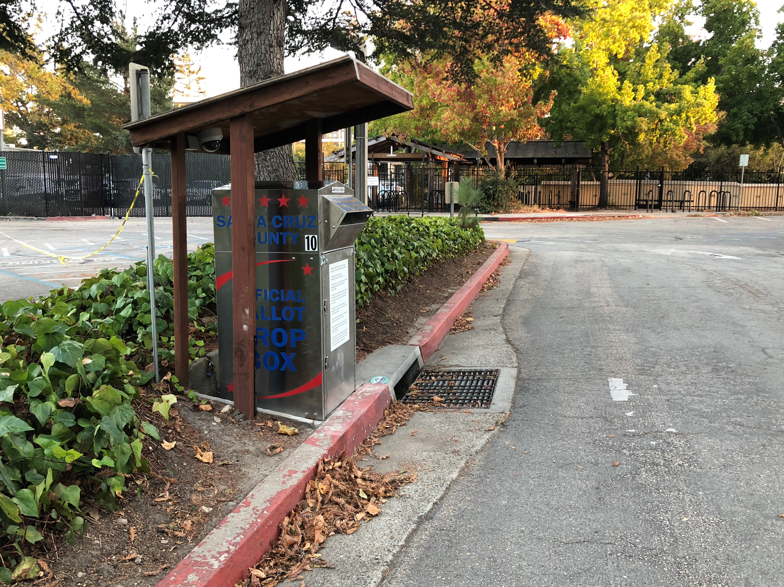
Just because we mail you a ballot, you don’t have to mail it back!
We will have 15 ballot drop boxes available 24/7 from October 6 until 8pm on Tuesday, November 3.

Slide 7
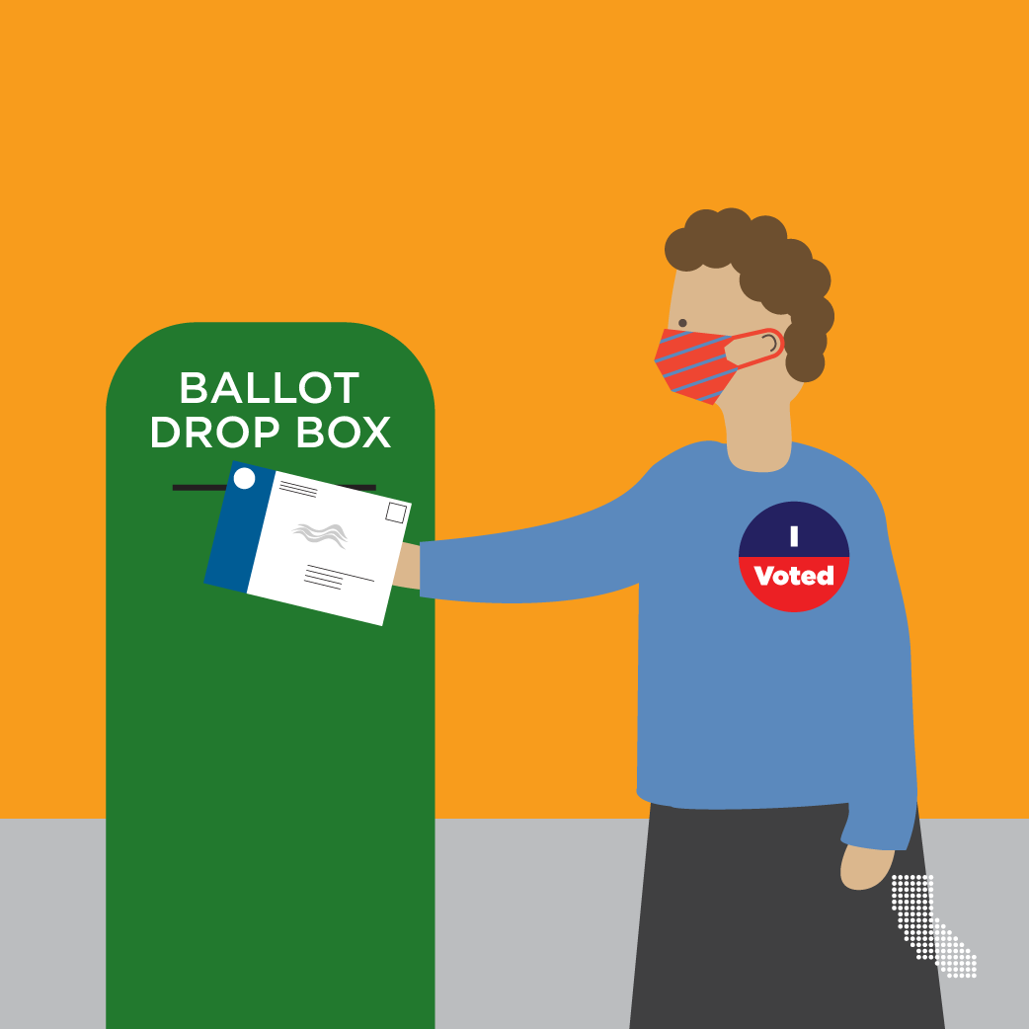
Ballot drop box locations
Aptos - Public Library, 7695 Soquel Dr.
Aptos - Polo Grounds, 2255 Huntington Dr.
Aptos - Cabrillo College by football stadium, 3732 Cabrillo College Dr.
Ben Lomond - Highlands Park, 8500 Highway 9
Boulder Creek - Library, 13390 W. Park Ave.: walk up
Capitola - City Hall, 420 Capitola Ave.
Capitola - Shopping Mall (near Sears), 1855 41st Ave.
Felton - Covered Bridge Park, Mt. Hermon/Graham Hill Rd.
Santa Cruz - County Gov. Center, 701 Ocean St.
Santa Cruz - Public Library, 212 Church St.
Santa Cruz - UCSC Quarry Plaza: walk up
Scotts Valley - City Hall, 1 Civic Center Dr.
Watsonville - Parking Lot 14, 316 Rodriguez St.
Watsonville - County Health Center, 1430 Freedom Blvd.
Watsonville - Corralitos Community Center, 35 Browns Valley Rd.

Slide 8
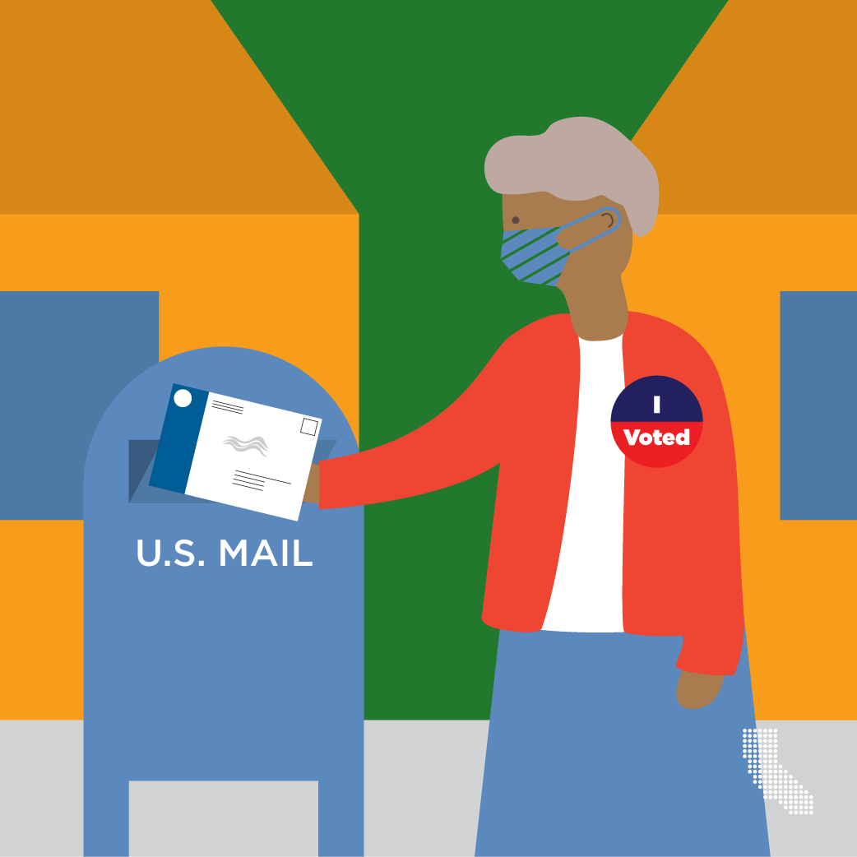
If you mail your ballot, make sure it is postmarked on or before November 3!
Ballots postmarked on or before November 3 and received by the elections official by November 20 will be considered received on time and will be counted if the voter is eligible to vote.
If you mail it on November 3, walk it in to the post office and have it postmarked!
Postage is paid!

Slide 9
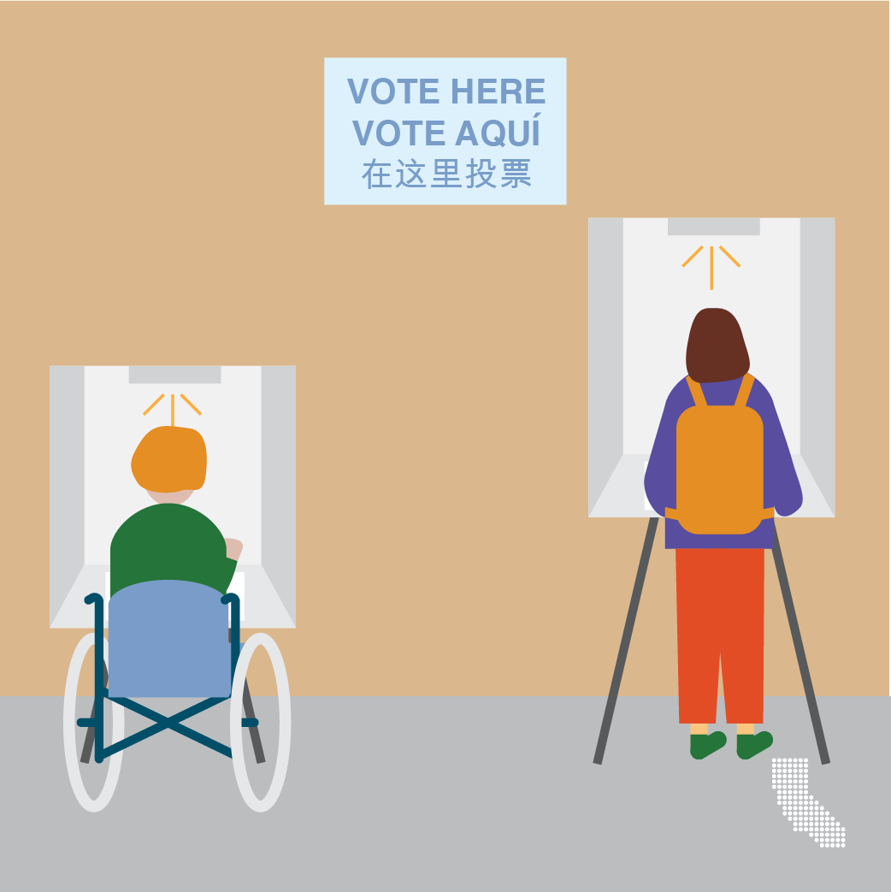
In-Person voting locations
Aptos - Temple Beth El, 3055 Porter Gulch Rd.
Boulder Creek - Boulder Creek Recreation Hall, 13333 Middleton Ave.
Capitola - New Brighton Middle School, 250 Washburn Ave.
Felton - San Lorenzo Valley High School, 7105 Highway 9
Santa Cruz - Santa Cruz County Clerk/Elections, 701 Ocean St., Room 310
Santa Cruz - Simpkins Swim Center, 979 17th Ave.
Santa Cruz - Bonny Doon Elementary School, 1492 Pine Flat Rd.
Santa Cruz - Kaiser Permanente Arena, 140 Front St.
Santa Cruz – Masonic Center, 828 N. Branciforte Ave.
Santa Cruz - Natural Bridges School, 255 Swift St.
Scotts Valley - Scott Valley Community Center, 360 Kings Village Rd.
Scotts Valley - SV High School, 555 Glenwood Dr.
Soquel - Soquel Conference Center, 1931 Old San Jose Rd.
Watsonville - Watsonville City Clerk Office/Community Room, 275 Main St., 4th Floor
Watsonville - Pajaro Valley Community Trust, 85 Nielson St.
Watsonville - La Selva Beach Clubhouse, 314 Estrella Ave.
Watsonville - Santa Cruz County Fairgrounds, 2601 East Lake Ave.
Watsonville - Calabasas Elementary School, 202 Calabasas Rd.
Santa Cruz - UCSC, Merrill Cultural Center - open ONLY Monday, November 2, 2020, 8am
to 5pm and Tuesday, November 3, 2020, 7am to 8pm
We will have an app to track wait times!
Subject to change due to the CZU fires. Some locations may be damaged, and some are being used as shelters.

Slide 10
Voting location safety checklist
✓ Wear a face covering while at the voting location.
✓ Keep 2 arms’ length distance from other people.
✓ Wash hands before and after entering the voting location.
✓ Use hand sanitizer after touching doors or voting equipment.
✓ Bring a ballpoint pen to avoid touching high-contact surfaces.
Want more information about how to stay safe while voting?
Review Centers for Disease Control and Prevention guidelines at www.cdc.gov/coronavirus/2019-ncov/community/election-polling-locations.html

Slide 11

Services for persons with disabilities
Remote Accessible Vote-by-Mail Ballot (RAVBM)
At the voting location
In some voting locations, temporary thresholds, ramps, signage, cones, and door props are used to improve access to the facility.
Curbside voting
If the voting location is not accessible, you may vote on a paper ballot from a nearby accessible location, including a car. A poll worker will qualify you to vote and will return the voted ballot to the voting location.
To request curbside voting assistance, you can:
call in advance to coordinate a time and place
have an assistant make the request inside the voting location
Accessible voting system
Each voting location in the county has a tablet with:
an audio option that reads the ballot to you
a universal plug for personal assistive device
large print (24 points)
a choice of English or Spanish
A ride to your voting location
We can arrange to have an accessible van pick you up and take you to a voting location in Santa Cruz County to vote. Please call 831-454-2060 by Friday, October 30 to make an appointment.
Ballot delivery to your home
We can deliver a ballot to your home and return it to the Elections Department. Please call 831-454-2060 before Election Day so there will be enough time to assist you.

Slide 12

Language services
The following election materials will be translated into Spanish and will be available at all our voting locations:
A Spanish version of the ballot on the tablet
Voting Instructions
State Voter Information Guide
Voter Bill of Rights
Assistance with voting
As a voter, you may bring up to two individuals with you to your polling place to help you cast your ballot if those individuals do not represent your employer or your union. Your polling place may have poll workers ready to assist you who speak Spanish.
Spanish ballot will be mailed to you
Since all voters will be mailed a ballot for the November election, we will also mail you a copy of your ballot in Spanish. It will be in a separate mailing from your official ballot.

Slide 13
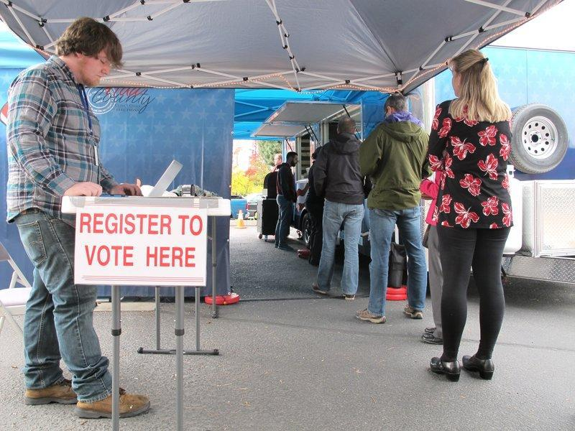
VoteMobile – can go anywhere
Ideas??
Davenport
Bonny Doon
Summit
Residential care facilities

Slide 14

Ballot safety & security
Postmark + 17 (new law)
Ballots that are postmarked on or before Election Day or are time stamped or date stamped by a bona fide private mail delivery company on or before Election Day and received by the county elections official by the 17th day after the election – November 20 – shall be considered received on time.
In March 2020, 70,678 vote-by-mail ballots were cast
  852 ballots were challenged
  632 were due to arriving too late, 76.6% of those challenged

Slide 15
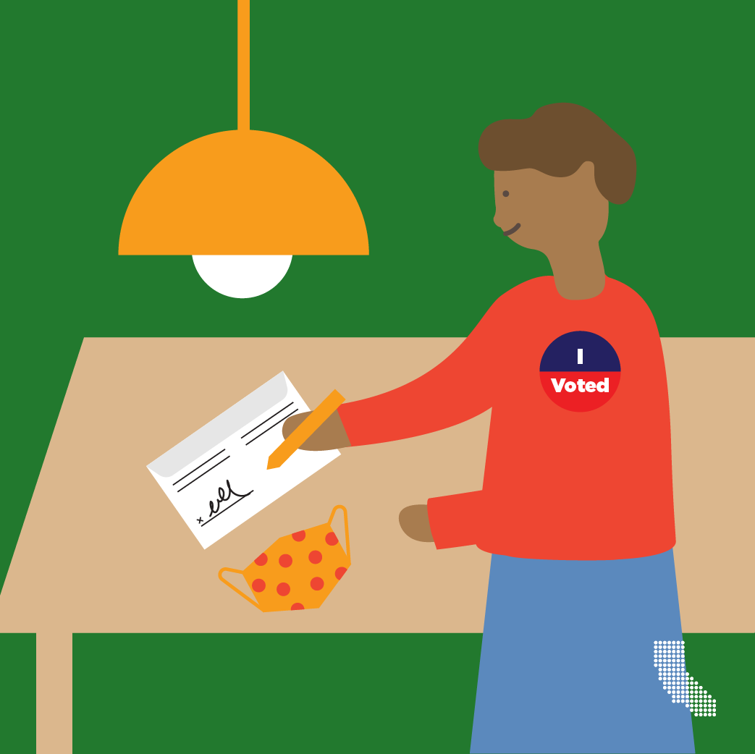
The signature on the ballot envelope is compared to the signature on file by humans
The tab covering your signature will be pealed off by staff when your ballot arrives.
It will then be sent through a ballot processing machine that will capture the signature digitally.
An elections clerk at a computer station can compare the signature on the envelope to the signature we have on file from the voter registration card or mail ballots from past elections.
The computer displays 5 voters’ signatures at a time.

Slide 16
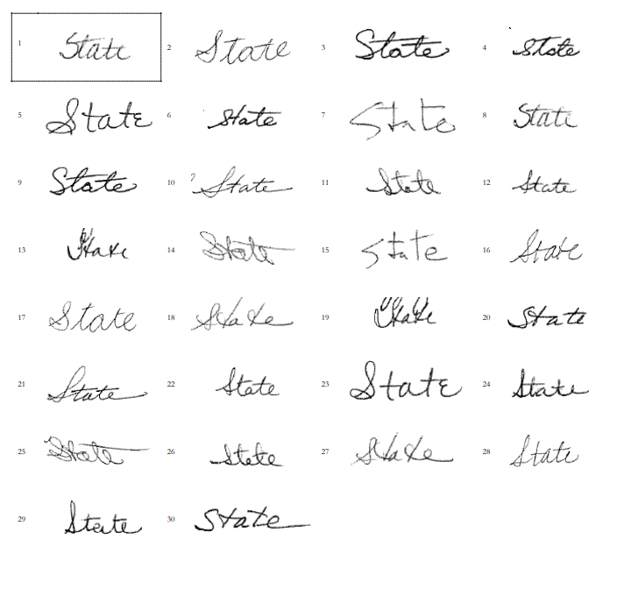
What if my signature has changed?
We know sigs change, and we can tell if someone has aged and it has effected the handwriting.
In March out of 70,678 vote-by-mail ballots cast:
  108 (.0015%) were challenged for no signature (77 were cured)
  95 (.0013%) were challenged because the signature did not compare (35 were cured)
Staff has attended signature verification training classes.

Slide 17

In comparing signatures we consider:
Slant of the signature.
Signature is printed or in cursive.
Size, proportions, or scale.
Individual characteristics, such as how the “t’s” are crossed, “i’s” are dotted, or loops are made on the letters f, g, j, y, or z.
Spacing between the letters within the first and/or last name and between first and last name.
Line direction.
Letter formations.
Proportion or ratio of the letters in the signature.
Initial strokes and connecting strokes of the signature.
Similar endings such as an abrupt end, a long tail, or loop back around.
Speed of the writing.
Presence or absence of pen lifts.
Surface of the location where the signature was made.
Any other noticeable discrepancy such as misspelled names.
And, we will look at the printing

Slide 18
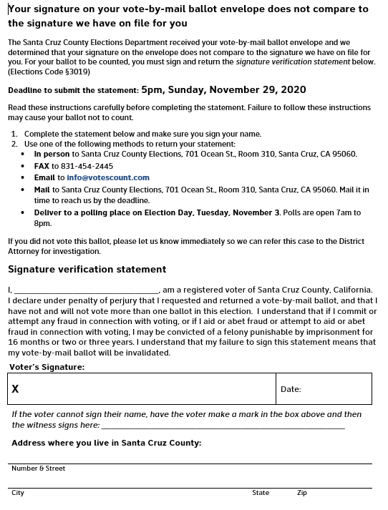
If your signature is challenged
If your signature does not compare, a second elections official will inspect your signature.
If they do not believe it compares, the County Clerk or the Assistant County Clerk will determine if your ballot should be challenged due to a signature that does not compare.
If your ballot is challenged, you will be contacted using the information you provided on the ballot envelope. If you cannot be reached by telephone or email, we will mail you a letter with a Signature Verification Statement so you can cure your signature.
The Signature Verification Statement may be returned to the county elections official by mail, FAX, email, hand-delivered, or dropped off at a voting location or drop box if we have contacted you before Election Day.
The Signature Verification Statement must be received by the elections official by Sunday, November 29.

Slide 19
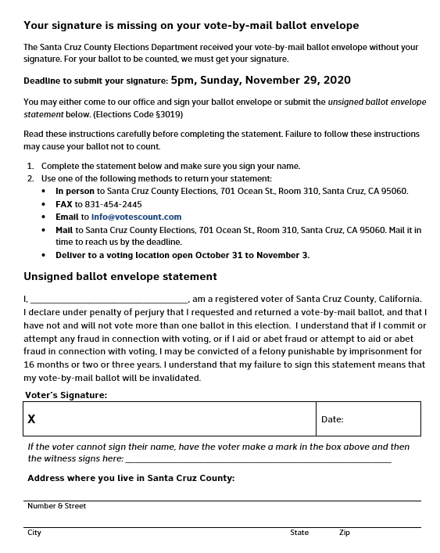
If you forget to sign your ballot envelope
We will contact you and ask you to complete the Unsigned Ballot Envelope Statement so we can collect your signature and count your ballot.
The Statement is due by Sunday, November 29.

Slide 20

No electioneering
No one can solicit the vote of a vote-by-mail voter, or do any electioneering, while in the residence or in the immediate presence of the voter, and during the time he or she knows the vote-by-mail voter is voting.
Any person who knowingly violates this section is guilty of a misdemeanor.

Slide 21
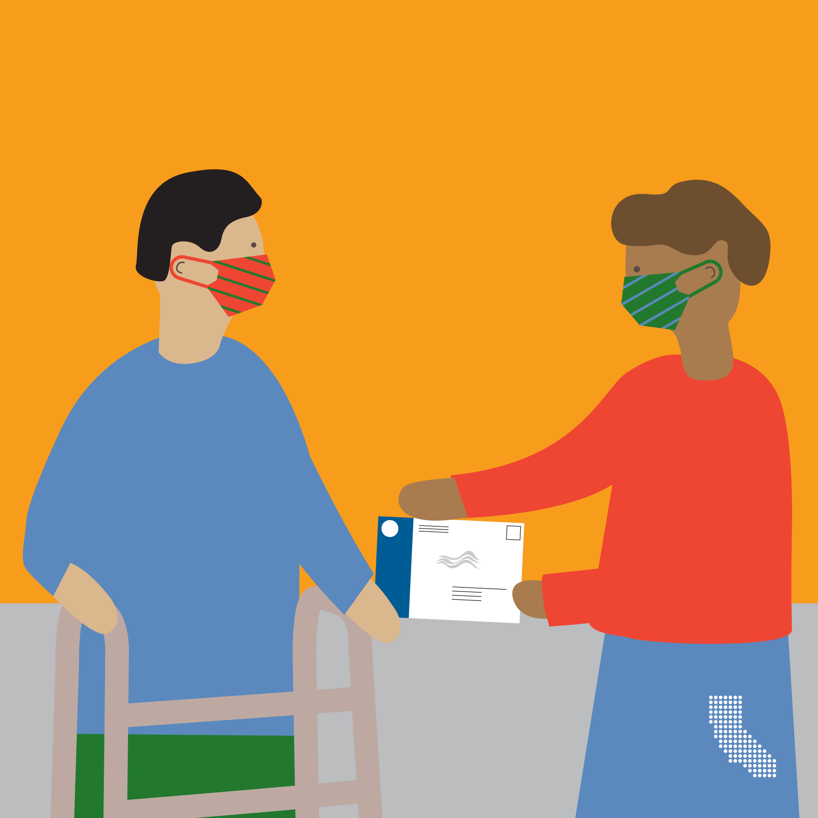
Don’t let a stranger return your ballot
There have been concerns raised about ballot collection from third parties. California changed the ballot return law in 2016 to allow any person to return a ballot for a voter. The person returning the ballot must print their name, sign their name, and provide their relationship to the voter on the outside of the envelope. The law used to require the third party to be a relative, household member or the caretaker of the voter.
If a voter cannot return their ballot without assistance, they are encouraged to enlist the help of someone they know and trust. If they do not have anyone available, they can call our office at 831-454-2060 and we will send an elections official to pick up the ballot.
In my experience, I have not seen any abuse of this expanded law in Santa Cruz County.

Slide 22
What about voter fraud?
In a Washington Post analysis of data collected by three vote-by-mail states with help from the nonprofit Electronic Registration Information Center (ERIC) found that officials identified just 372 possible cases of double voting or voting on behalf of deceased people out of about 14.6 million votes cast by mail in the 2016 and 2018 general elections, or 0.0025%.
The Heritage Foundation maintains a database of all recent instances of recorded voter fraud and found just 204 reported cases involving the fraudulent use of vote-by-mail ballots over the past 20 years — only 143 resulted in convictions. That means that over the last two decades, about 0.00006% of total vote-by-mail votes cast were fraudulent.
In Santa Cruz County, since 1993 there has been 1 case of voter fraud where a property owner voted and returned a ballot for a tenant. We caught the incident during our standard signature checking procedures.
Most cases are people guilty of “over-helping.” Spouses signing for the other. Parents signing for their children.
Bottom line. It is your ballot. Sign it in your own handwriting!

Slide 23
If you see something, SAY SOMETHING!
If you suspect voter fraud, please contact the Secretary of State. They have a complaint form posted online at https://www.sos.ca.gov/elections/publications-and-resources/voter-complaint/
You may also call the Secretary of State at:
English: (916) 657-2166 or (800) 345-VOTE (8683).
Spanish: (800) 232-VOTA (8682)
You may also contact the Santa Cruz County Clerk at 831-454-2060 or info@votescount.us. The County Clerk is not authorized to do investigations, so the office will refer the case to the appropriate local agency.

Slide 24
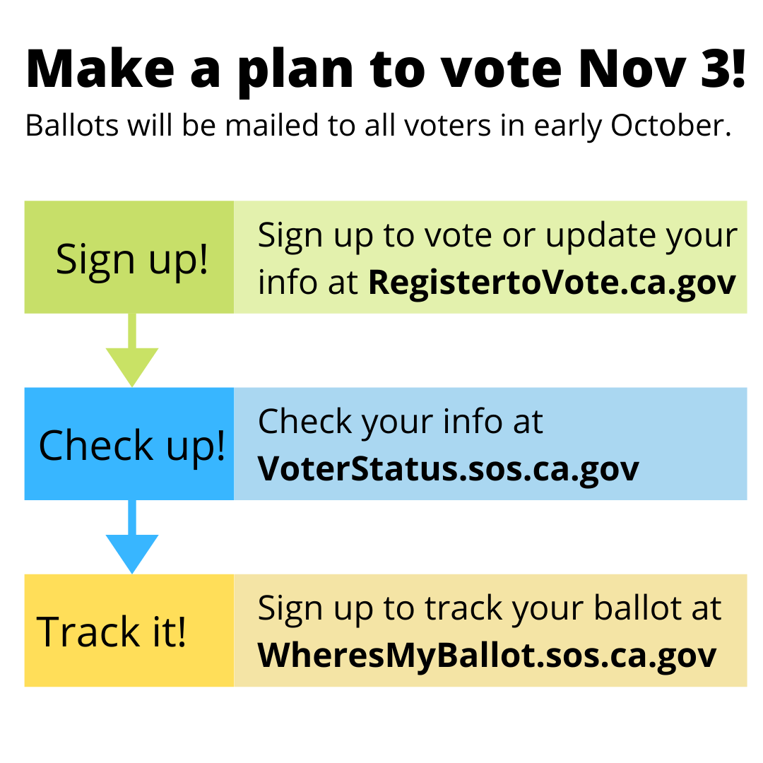
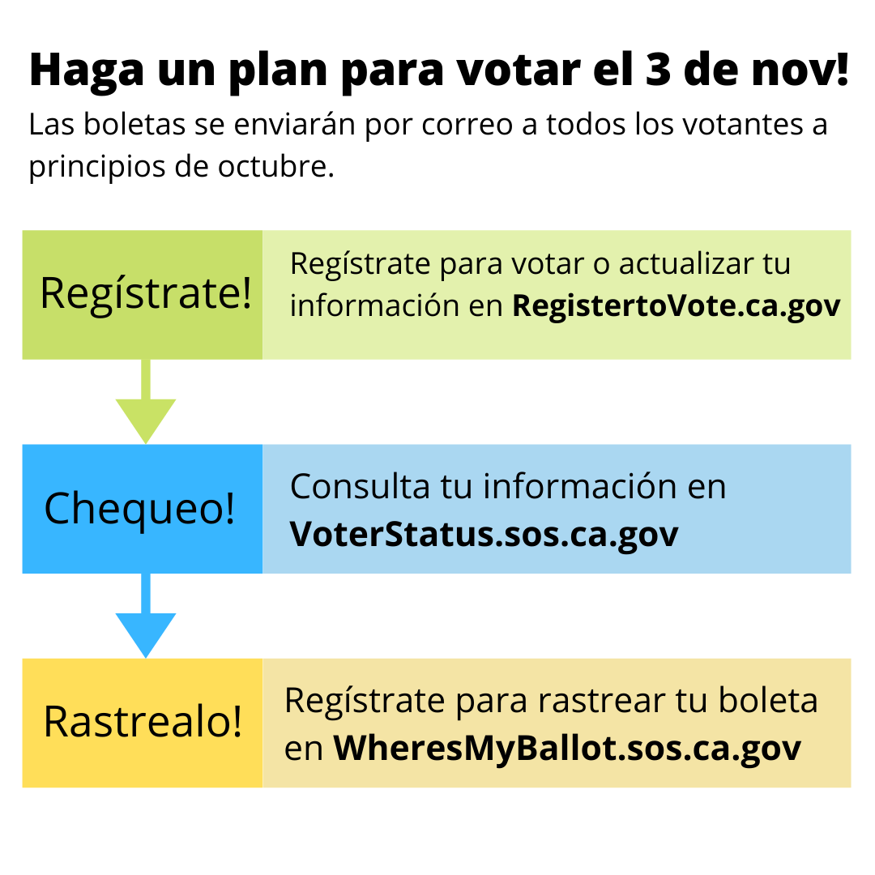
Make a plan to vote!

Slide 25
Help us spread the word! Be a trusted messenger!
Ballots will be mailed to all active registered voters by October 5.
Register to vote online at registertovote.ca.gov
If you don’t have a CA driver’s license or ID, you will need to print, sign and return your voter registration. Or pick up a voter registration card at any post office, library, city hall, county elections, or we can mail voters a card.
Deadline to register is October 19. Same Day Registration is available for those who miss the deadline.
Check to make sure your voter information is correct at voterstatus.ca.gov
Sign up to track your ballot at wheresmyballot.sos.ca.gov

Slide 26
More information to share…
Sign your ballot envelope in your own handwriting. Don’t let anyone sign for you.
Know your voting rights! No electioneering while you are voting at home.
If you can’t return your ballot yourself, enlist the help of someone you trust. The person returning the ballot must print their name, sign and indicate their relationship to the voter on the ballot return envelope.
Quick and easy way to return your ballot is to use one of our drive-up or walk-up ballot drop boxes available 24/7 until 8pm Election Day.
County Elections and Watsonville City Clerk are open for voting starting Monday, October 5.
There will be in-person voting locations for people to return their ballot, get a replacement ballot, vote on the tablet, or register and vote on the same day.
Military and overseas voters will be sent their ballot beginning September 4. Most will be emailed, but some are mailed. Military and overseas voters are allowed to FAX their ballot back.

Slide 27
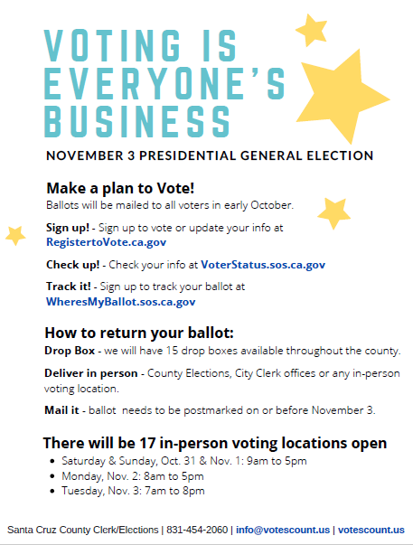
If you own a business, we need you!
Post our sign “Voting is everyone’s business”
Have voter registration cards and promote National Voter Registration Day
Contact Helen Ruiz-Thomas at 831-454-3389 or helen.ruiz-thomas@santacruzcounty.us

Slide 28
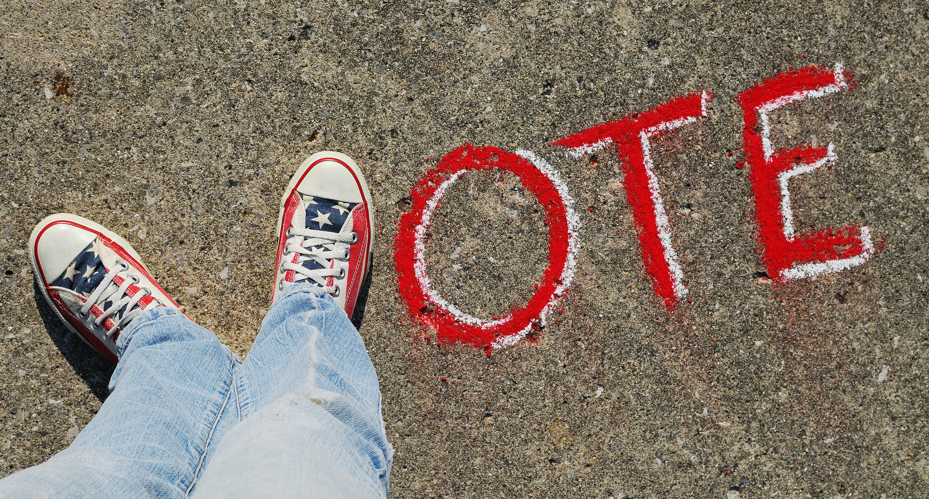
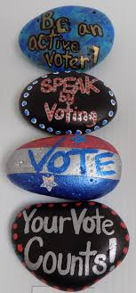
How you can spread the word
Talk to your family, friends, neighbors
Chalk art
Rock art
Car art
Social media
Newsletters (churches, schools, groups, organizations)
Email
Yard signs to promote voting!

Slide 29

Delivering democracy takes many people
Voting locations – people who have signed up to work all 4 days will be assigned in early October.
More people will be assigned to work Tuesday only.
A team will be assigned to manage the VoteMobile.
Online training will be required of ALL election workers.
Two-person teams are being assigned to manage the ballot drop boxes. We need 15 two person teams, one at each box, on Election Night, November 3, to empty and lock each ballot drop box.
Election Worker hotline – staffed by county employees and some volunteers.
Voter Hotline – staffed by county employees.

Slide 30

Key dates and milestones
Sept. 14, 2020 - 50 Days until Election Day!
Sept. 15, 2020 to Oct. 15, 2020 - Hispanic Heritage Month.
Sept. 17, 2020 - National Citizenship Day.
Sept. 22, 2020 - National Voter Registration Day.
Sept. 24, 2020 - State Voter Information Guide mailings begin.
Oct. 5, 2020 - Ballots mailed out by election offices. County Elections and Watsonville City Clerk open for voting.
Oct. 6, 2020 - Drop Boxes are available.
Oct. 12, 2020 - Indigenous Peoples’ Day.
Oct. 19, 2020 - Close of Registration for administrative purposes. Voters may still register and vote right up through Election Day.
Oct. 31, 2020 - Happy Halloween – 15 additional in-person voting locations open.
Nov. 3, 2020 - Election Day is the last day to vote!

Slide 31
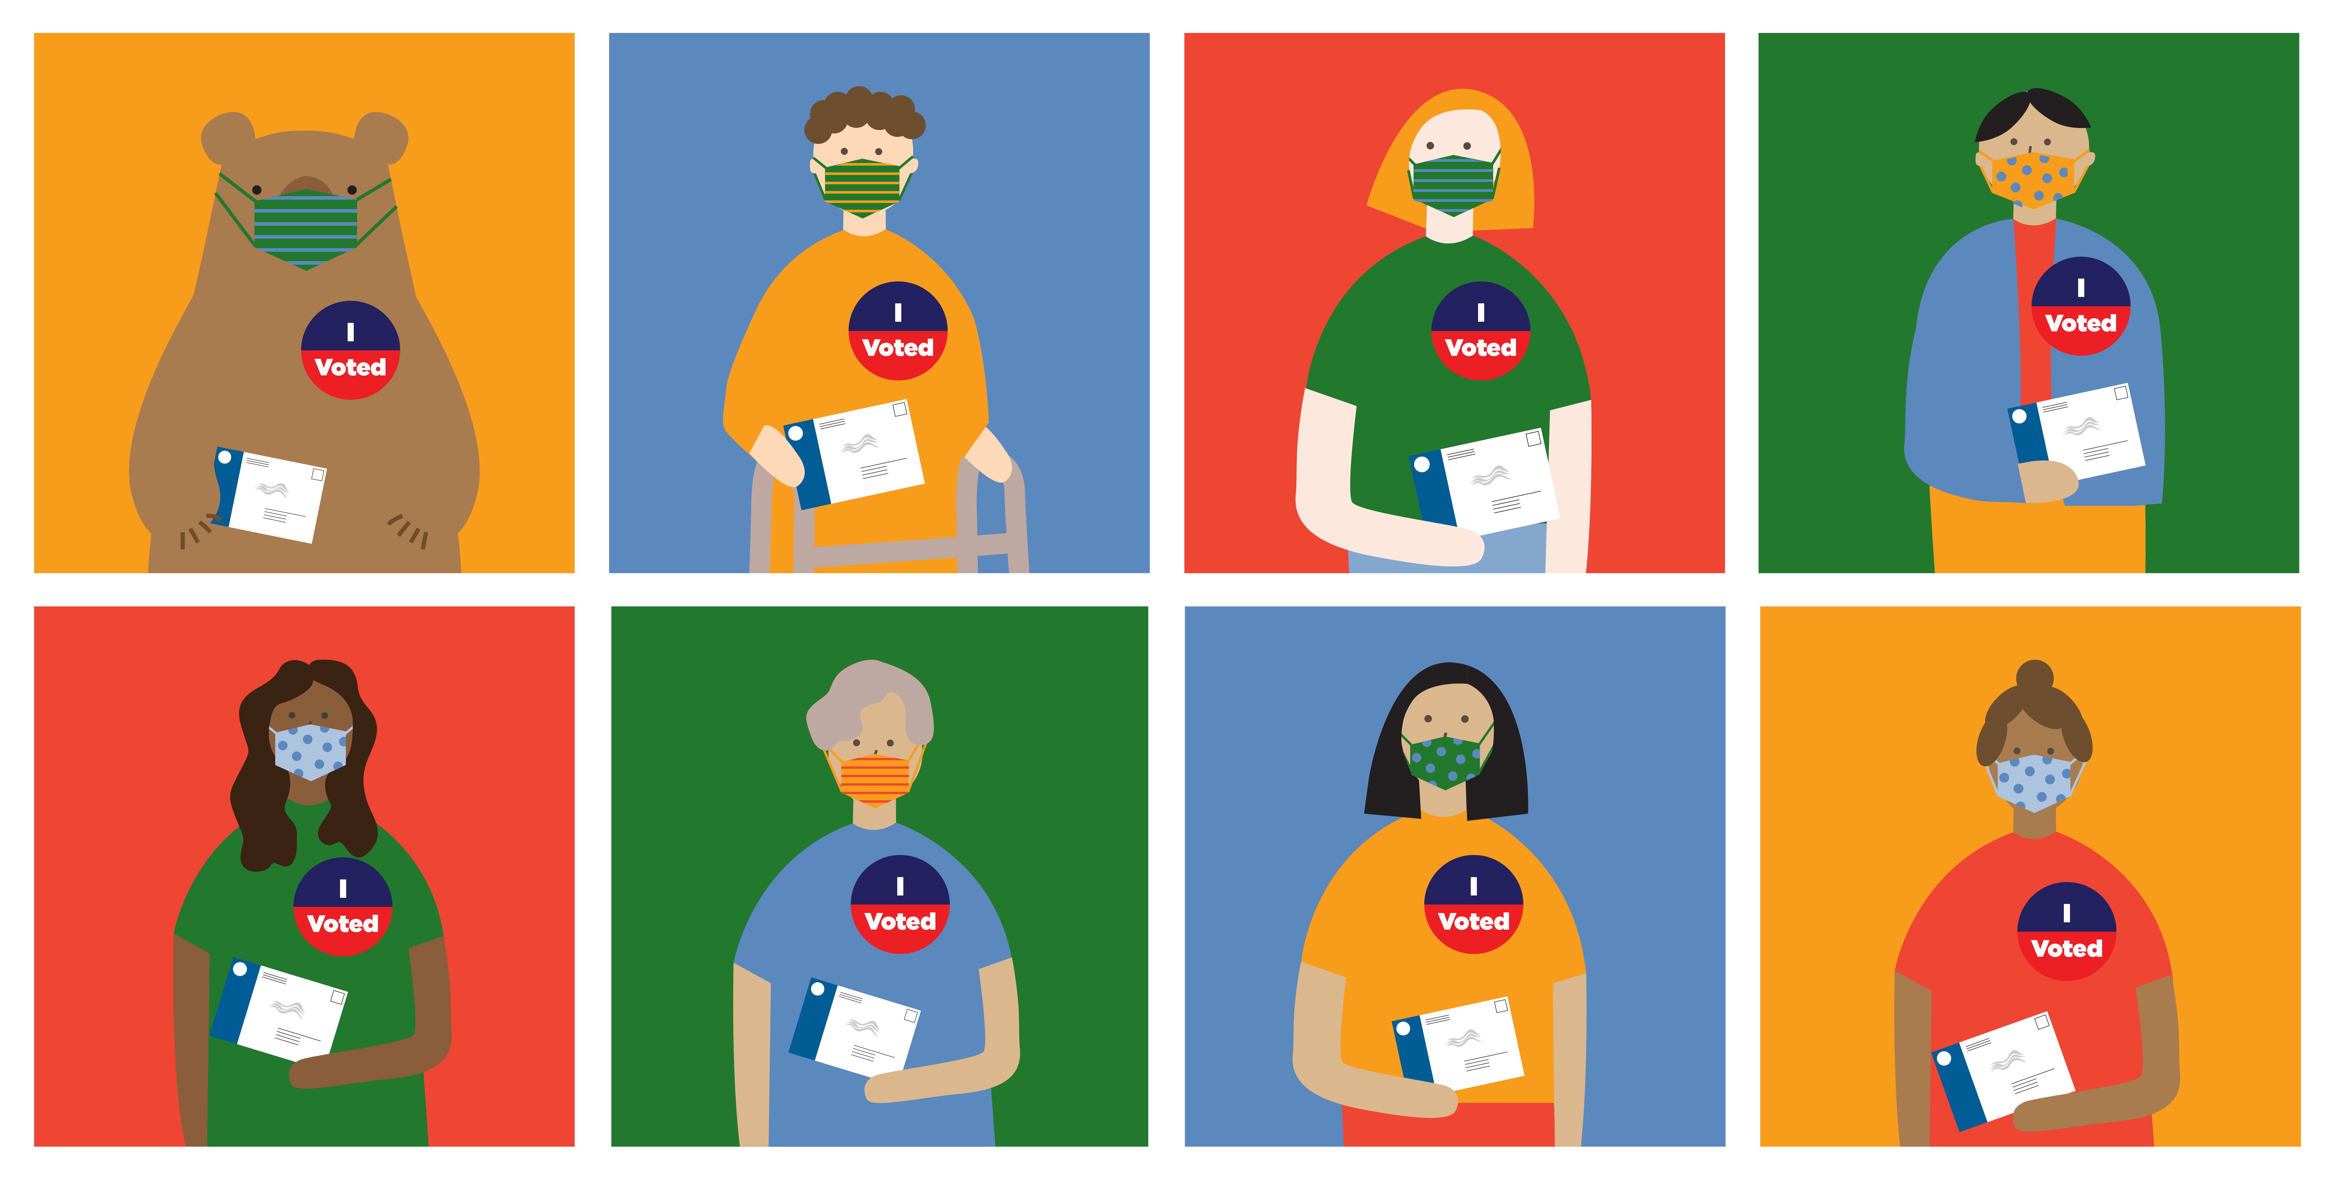
Thank you for participating!
Gail L. Pellerin
County Clerk
831-454-2060 (main)
831-454-2419 (direct)
info@votescount.us
www.votescount.us
Special thanks to
Tammy Patrick
Future of California Elections

